Slide 1
UNIT 1
Introduction to Generative Deep Learning
By: Prof. Rajesh R M
Assistant Professor
Dept. of AI and ML
RVCE, Bangalore

Slide 2
Outline
Generative Modeling What Is Generative Modeling?
Historical perspective on Generative AI
Generative Versus Discriminative Modeling
Introduction to Large Language Models (LLMs)
Applications of Large Language Models
Limitations and Risks of Large Language Models

Slide 3
What Is Generative Modeling?
Generative modeling can be broadly defined as follows:
“Generative modeling is a branch of machine learning that involves training a model to produce new data that is similar to a given dataset.”

Slide 4
What Is Generative Modeling?
A generative model trained to generate realistic photos of horses

Slide 5
What Is Generative Modeling?
Training Data:
In order to build a generative model, we require a dataset consisting of many examples of the entity we are trying to generate. This is known as the training data, and one such data point is called an observation.
Each observation consists of many features
For an image generation problem, the features are usually the individual pixel values[Relationship].
For a text generation problem, the features could be individual words or groups of letters.

Slide 6
What Is Generative Modeling?
A generative model must also be probabilistic rather than deterministic, because we want to be able to sample many different variations of the output, rather than get the same output every time.
If our model is merely a fixed calculation, such as taking the average value of each pixel in the training dataset, it is not generative.
Generative AI model must include a random component that influences the individual samples generated by the model.
It is our job to build a model that mimics this distribution as closely as possible and then sample from it to generate new, distinct observations that look as if they could have been included in the original training set.

Slide 7
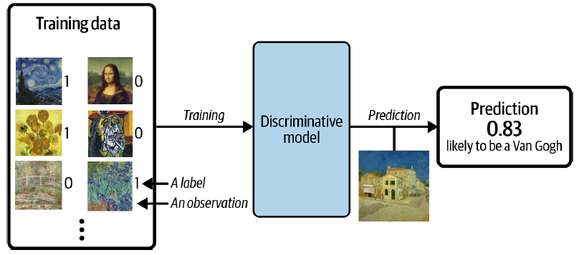
Generative Versus Discriminative Modeling
A discriminative model trained to predict if a given image is painted by Van Gogh

Slide 8
Generative Versus Discriminative Modeling
When performing discriminative modeling, each observation in the training data has a label.
For a binary classification problem such as our artist discriminator, Van Gogh paintings would be labeled 1 and non–Van Gogh paintings labeled 0
Our model then earns how to discriminate between these two groups and outputs the probability that a new observation has label 1—i.e., that it was painted by Van Gogh.
In contrast, generative modeling doesn’t require the dataset to be labeled because it concerns itself with generating entirely new images, rather than trying to predict a label of a given image.

Slide 9
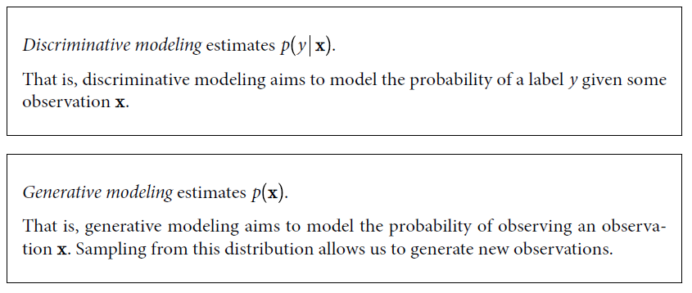
Generative Versus Discriminative Modeling

Slide 10
Generative Versus Discriminative Modeling
Conditional Generative Models
Note that we can also build a generative model to model the conditional probability p y —the probability of seeing an observation with a specific label y.
For example, if our dataset contains different types of fruit, we could tell our generative model to specifically generate an image of an apple.

Slide 11
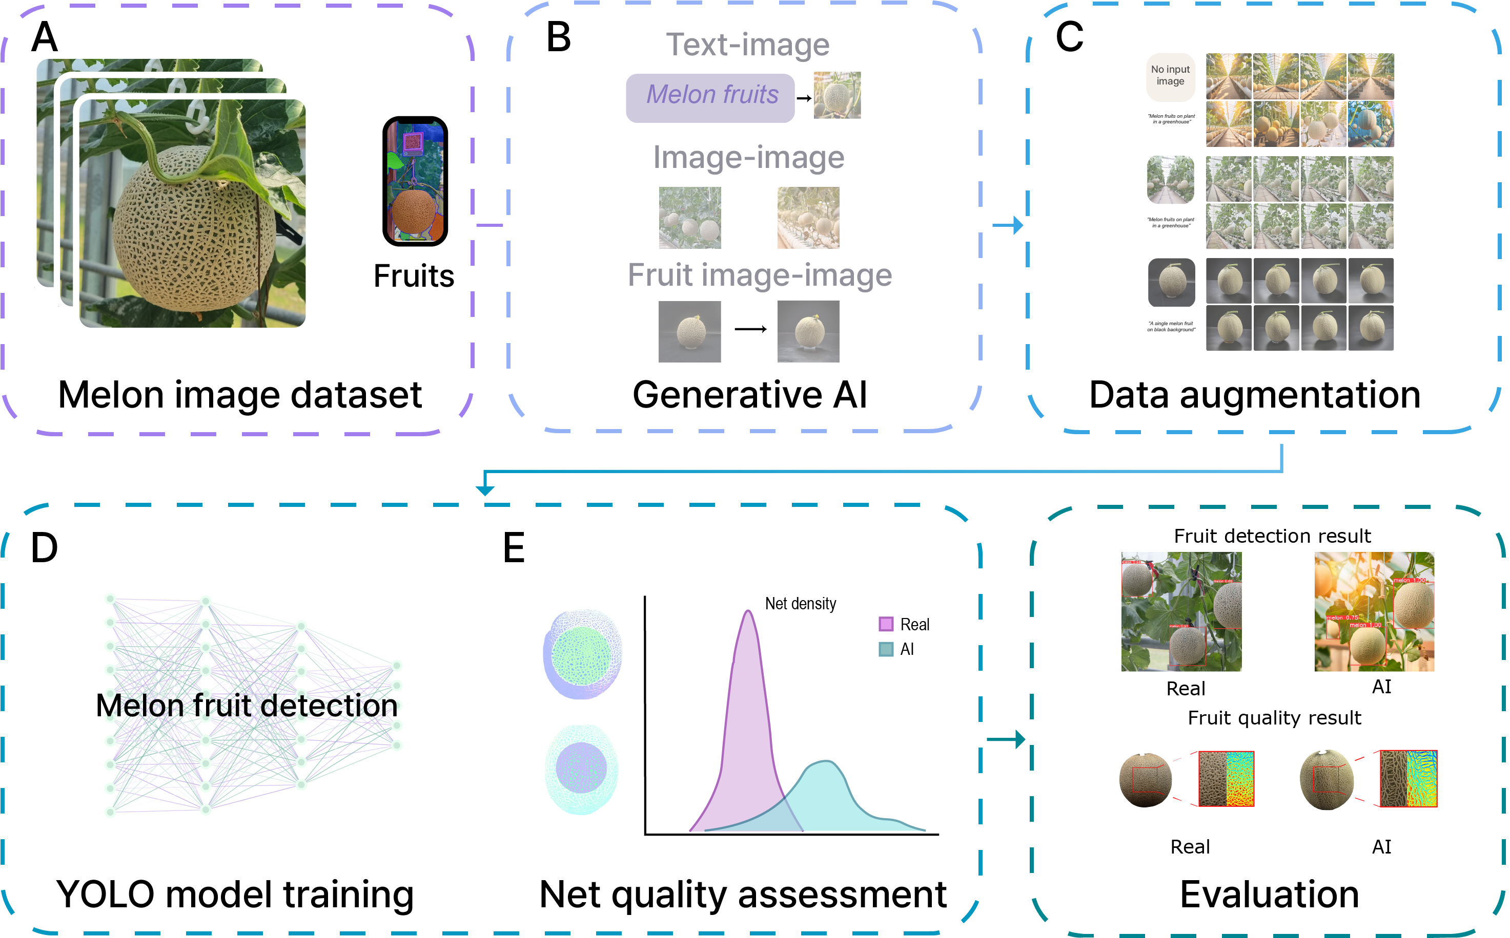
Conditional Generative Models

Slide 12
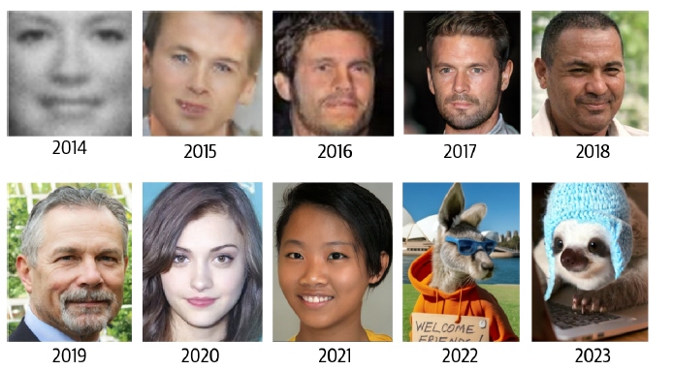
The Rise of Generative Modeling
Face generation using generative modeling has improved significantly over the last decade

Slide 13
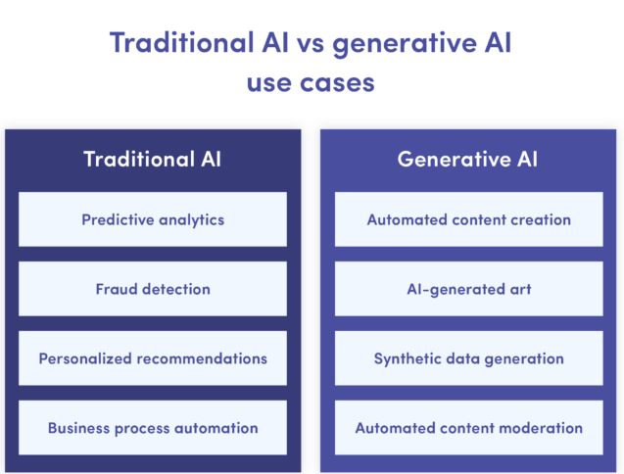
Difference Between Gen AI and Traditional AI

Slide 14
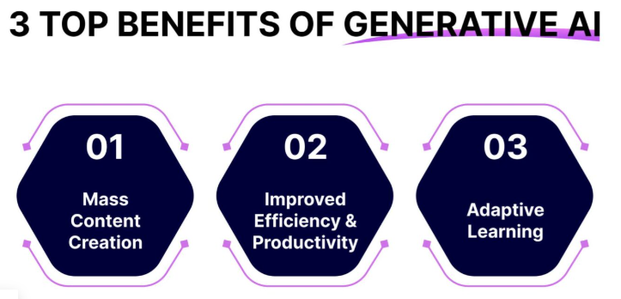

Slide 15
3 Top Challenges of AI and Gen AI
1. Data Bias
We all know that AI and gen AI models are trained on vast amounts of data. The biases in this training data may lead to inaccurate outcomes.
Removing any biased data to achieve accurate outcomes from these systems is crucial to avoid discrimination.
2. Lack of AI Explainability
You might have used generative AI systems to automate your daily operations. But have you ever wondered how these systems reach a specific conclusion? Maybe Not.
There is no proper justification for how AI and gen AI models provide recommendations. This can raise questions about their reliability and break the trust of many.

Slide 16
3 Top Challenges of AI and Gen AI
3. Data Privacy & Security
Data security and privacy are among the major concerns of artificial intelligence.
These gen AI and AI systems are more vulnerable to cyber-attacks. Moreover, will you be okay if your data is unsafe and anyone can access it? No, Right? The same holds for patients. They are highly sensitive about their data privacy.
Organizations unable to protect patient data can face legal action. It is crucial to ensure that the AI systems comply with regulatory authorities

Slide 17
Introduction to Large Language Models (LLMs)
Introduction to Large Language Models (LLMs)
Large Language Models (LLMs) are advanced artificial intelligence systems designed to process and generate human-like text based on vast amounts of data. They are built using deep learning techniques, particularly transformer architectures, which enable them to analyze and generate language with remarkable fluency and coherence.
Key Features:
Trained on diverse datasets including books, articles, and online content.
Can handle tasks like translation, summarization, text generation, and question answering.
Adaptable to various domains with fine-tuning.

Slide 18
Introduction to Large Language Models (LLMs)
Popular LLMs:
GPT Series (OpenAI): Generative models for text generation and understanding.
BERT (Google): Optimized for understanding sentence context and relationships.
Bidirectional Encoder Representations from Transformers
PaLM (Pathway Language Models)
The Pathways Language Model is the name of a family of AI large language models developed by Google. The effort gets its name from a Google Research initiative to create what researchers dubbed pathways, in an approach designed to build a single powerful model that could serve as a foundation for multiple use cases.
LLaMA
Large Language Model Meta AI
LLaMA(Large Language Model Meta AI) is a collection of state-of-the-art foundation language models

Slide 19
Introduction to Large Language Models (LLMs)
Applications of Large Language Models
LLMs have revolutionized multiple fields by offering versatile solutions.
Natural Language Processing (NLP) Tasks:
Text summarization (e.g., extracting key points from articles).
Machine translation (e.g., translating between languages).
Sentiment analysis for reviews, social media, etc.
Content Creation:
Generating articles, blogs, stories, or code.
Assisting in scriptwriting and creative writing.

Slide 20
Introduction to Large Language Models (LLMs)
Chatbots and Virtual Assistants:
Powering tools like ChatGPT and Alexa for interactive communication.
Customer support automation.
Education and Research:
Personalized tutoring systems.
Generating research summaries or literature reviews.
Healthcare:
Assisting in medical diagnosis through natural language queries.
Summarizing patient records.

Slide 21
Introduction to Large Language Models (LLMs)
Programming and Development:
Code generation and debugging (e.g., GitHub Copilot).
Automating routine tasks for developers.
Legal and Business:
Contract analysis and summarization.
Drafting legal documents or business plans.

Slide 22
Introduction to Large Language Models (LLMs)
Limitations and Risks of Large Language Models
Despite their capabilities, LLMs have several limitations and risks:
Limitations:
Dependency on Training Data:
Performance depends on the quality and diversity of training datasets.
May lack updated information post-training.
Inability to Reason Like Humans:
Struggles with logical reasoning or handling complex multi-step tasks.

Slide 23
Introduction to Large Language Models (LLMs)
Context Understanding Issues:
Can misinterpret ambiguous or nuanced inputs.
Resource Intensive:
Requires significant computational power and memory, making deployment costly.

Slide 24
Introduction to Large Language Models (LLMs)
Risks:
Misinformation Generation:
Can produce incorrect, biased, or misleading content with high confidence.
Ethical Concerns:
Risk of misuse for spam, disinformation campaigns, or malicious purposes.
Amplification of societal biases present in training data.
Privacy Concerns:
May inadvertently leak sensitive information embedded in training data.
Over-reliance:
Excessive dependency on LLMs may reduce critical thinking skills in users.
Job Displacement:
Potential impact on roles involving repetitive or language-based tasks.

Slide 25
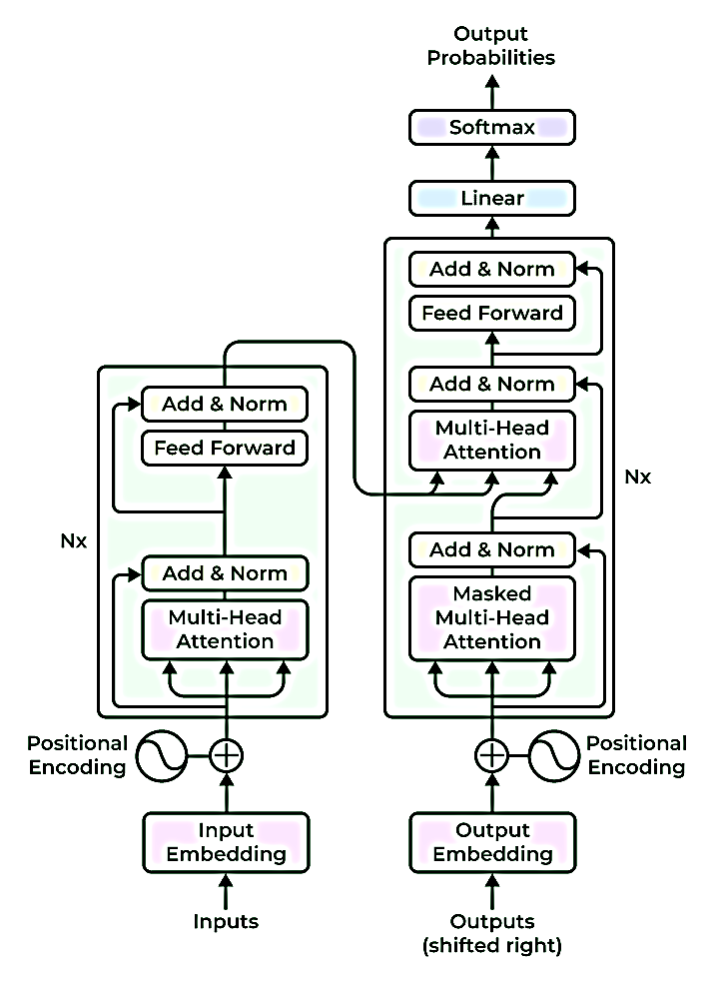
Introduction to Large Language Models (LLMs)
Input Embeddings: The input text is tokenized into smaller units, such as words or sub-words, and each token is embedded into a continuous vector representation. This embedding step captures the semantic and syntactic information of the input.
Positional Encoding: Positional encoding is added to the input embeddings to provide information about the positions of the tokens because transformers do not naturally encode the order of the tokens. This enables the model to process the tokens while taking their sequential order into account.

Slide 26
Introduction to Large Language Models (LLMs)
3. Encoder: Based on a neural network technique, the encoder analyses the input text and creates a number of hidden states that protect the context and meaning of text data. Multiple encoder layers make up the core of the transformer architecture. Self-attention mechanism and feed-forward neural network are the two fundamental sub-components of each encoder layer.
1. Self-Attention Mechanism: Self-attention enables the model to weigh the importance of different tokens in the input sequence by computing attention scores. It allows the model to consider the dependencies and relationships between different tokens in a context-aware manner.
2. Feed-Forward Neural Network: After the self-attention step, a feed-forward neural network is applied to each token independently. This network includes fully connected layers with non-linear activation functions, allowing the model to capture complex interactions between tokens.

Slide 27
Introduction to Large Language Models (LLMs)
Decoder Layers: In some transformer-based models, a decoder component is included in addition to the encoder. The decoder layers enable autoregressive generation, where the model can generate sequential outputs by attending to the previously generated tokens.
Multi-Head Attention: Transformers often employ multi-head attention, where self-attention is performed simultaneously with different learned attention weights. This allows the model to capture different types of relationships and attend to various parts of the input sequence simultaneously.
Layer Normalization: Layer normalization is applied after each sub-component or layer in the transformer architecture. It helps stabilize the learning process and improves the model’s ability to generalize across different inputs.
Output Layers: The output layers of the transformer model can vary depending on the specific task. For example, in language modeling, a linear projection followed by SoftMax activation is commonly used to generate the probability distribution over the next token.

